Slide 1


INTELLECTUAL CAPITAL
Frankfurt FFFM
March 2008 - Sept. 2009 – March 2013
Prof. Dr. Irene Martín-Rubio

Slide 2
WHY
INTELLECTUAL CAPITAL
NEW ECONOMY
  New management challenges
  Dot.com bubler burst in 1999:
    That unhappy event for many investors has masked a serious consideration of what is structurally new and different in developed economies.
  New business models by levering different resources forms
The responsibility for managing shareholder wealth now has new implications for understanding
  What resources are to be managed
  How and what is to be communicated to whom
  Under what conditions and through what media
  The profound importance of FUTURE value in the market valuation of equity.º

Slide 3
VALUATION OF THE FIRM
TRADITIONAL FINANCIAL REPORT
INTELLECTUAL CAPITAL REPORT

Slide 4
Traditional Enterprise Management Approach
INPUTS
Cap. Investment
Cost of Raw Capital
Cost of Labor
OUTPUTS
Revenues
Cash Flows
The Enterprise
=
Maximize the residual (= profit/value added)
Today, companies are not able any more to manage for real value added using traditional accounting systems and management tools!

Slide 5
TRADITIONAL VS. INTELLIGENT ENTERPRISE
EFFICIENT PRODUCTION | INTELLIGENT ENTERPRISE
Machinery & equipment Physical Infrastructure Inventory Resource/Assets can be acquired and deployed short term | Human + Intellectual capital Innovation Power R&D Pipeline Brands & Relationships Major resources have to be developed in-house Long/term
ENERGY+ INDUSTRIAL ASSETS | KNOWLEDGE + INTANGIBLE ASSETS
BALANCE SHEET, INCOME STATEME COST ACCOUNTING | TENSION BETWEEN VALUE CREATION & VALUE EXTRACTION Reporting and control instruments?

Slide 6
VALUE CREATION MIXER
Intangible competences:
  Culture, networks, human capital
Latent idle capabilities are what investors, in particular venture capitalists, are interested in.
The discovery and exploitation of this value shpaing space is the Key to IC & KM.

Slide 7
VALUATION OF THE FIRM
The importance of Intellectual Capital resources is
  not only illustrated by surveys of senior executives in many countries
  but is also inherent in the valuation of publicly listed companis on stock exchanges globally.

Slide 8
VALUATION OF THE FIRM
Finance theory was identifiable born at the beguing of 60’s.
VALUATION MODEL:
  The value of “asset-in-place”. The present value of the uniform perpetual earnings on assets currently held
  The value of the growth opportunities. The present value of the opportunities the firm offers for making additional investments in real assets that will yield more than the “normal” marker rate of return.
  Both present value calculations are made using the same “cost of capital” discount rate.
The important question for now is:
    HOW BIG A CONTRIBUTION TO “SHARE PRICES” DO FUTURE GROWTH EXPECTATIONS MAKE?
      ANSWER: AN ENORMOUS AMOUNT.
      SO THE BASIS FOR MANAGING RESOURCES AND WEALTH HAS SHIFTED FROM TRADITIONAL ECONOMIC ASSETS TO INTANGIBLE AND INTELLECTUCAL CAPITAL ASSETS.

Slide 9
INTELLECTUAL CAPITAL REPORT

Slide 10
INTELLECTUAL CAPITAL (IC)
IC can be defined as
  all nonmonetary and nonphysical resources that are fully or or partly controlled by the organization and that contribute to the organization’s value creation.

Slide 11
INTELLECTUAL CAPITAL, CATEGORIES
RELATIONAL
ORGANIZATIONAL
HUMAN
-------------------------------------------------------------
These IC resources all form the basis for potential competitive advantage but few of them are found in a document in a verifable form.
  Example: Brand is sometimes found in the balance sheet but the value assigned to it is in no way correlated to its realizable market value at any given time.

Slide 12
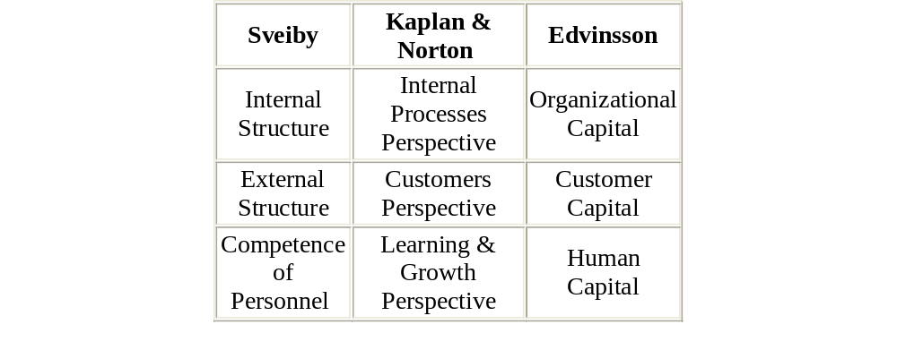
Three conceptual Frameworks for Intangible assets compared.
Financial capital

Slide 13
IC, RELATIONAL
These include all relationships that the organization has, such as customers, consumers, intermediaries, representatives, suppliers, partners, owners, lenders, and the like.

Slide 14
IC, RELATIONAL
Directly Busines Relationships
  Customers, Suppliers, Partners, Unions, Channels to market/representatives
Indirectly Business Relationships
  Owners, Banks, Media, Regulatory bodies, Pressure/interests groups, Local government, National government, Educational institutions, Sources of new knowledge (e.g. universities

Slide 15
IC, ORGANIZATIONAL
All those things that remain in the organization when the employees have left the building but that you cannot find in the balance sheet
      Leif Edvinsson
This includes resources such as brands, intellectual property, processes, systems, organizational structures, information (in paper or data bases) and the like.

Slide 16
IC, ORGANIZATIONAL
Externally Oriented: Brands, Trademarks, Service offerings, Product concepts, Patents and other IP
Internally Oriented: Processes, Organizational Structures, Systems, Information on paper, Information in databases, Software, Organizational culture

Slide 17
IC, HUMAN
All the atributes that relate to individuals as resources for the company and under the requirement that these attributes cannot be replaced by machines or written down on a piece of paper.
This includes resources such as competence, attitude, skill, tacit knowledge, personal networks, and the like.

Slide 18
IC, HUMAN
Competence:
  Specific Knowledge fields that encompases tacit aspects, Specific abilities that encompases tacit aspects, Brain power or processing capacity (IQ), Empaty, Ability o build personal networks, Ability to participate in (maintain) personal networks, Ability to use (leverage) personal networks.
Attitude:
  Behavioral traits including social intelligence, Motivation, Pace –sometimes known as sense of urgency,Endurance or perserverance
Intellectual Agility:
  Ability to innovate, Ability to imitate, Ability to adapt.

Slide 19
Components
IC components: definition, indicators, management focus
http://www.hse.ru/data/2012/09/06/1241673644/Intellectual_Capital.pdf

Slide 20
IC- Intellectual Capital Report
HUMAN CAPITAL: Knowledge, skills,attitudes, experiences and abilities of employees & managers, culture (values), commitment, loyalty, conflict & complaint-numbers, behaviour indicators
ORGANIZATION CAPITAL: R&D activities, organizational routines, procedures, systems, information systems, databases, intellectual property rights of the company,
RELATIONAL CAPITAL: all resources linked to the external relationships of the firm, with customers, suppliers, R&D partners, stakeholder relationships

Slide 21
PUTTING IC RESOURCES TO VALUE-CREATING USE
EVALUATION OF THE ORGANIZATION’S UNIQUE TRANSFORMATION STRUCTURE
HOW THE ORGANIZATION DEPLOYS ITS RESOURCES TO CREATE VALUE
SYSTEM DYNAMIC (BEHAVIORAL EFFECT
  INTELLECTUAL CAPITAL NAVIGATOR

Slide 22
INTELLECTUAL CAPITAL NAVIGATOR (ICN)
It is a numeric and visual representation of how management views resource deployment to create value
The ICN is about identifying transformations from one resource into another.

Slide 23
Examples - IC
SKANDIA NAVIGATOR
  http://www.som.cranfield.ac.uk/som/dinamic-content/research/cbp/2004,%20IC%20-%20defining%20KPIs%20for%20org%20KA.pdf
10 Years of Austrian Intellectual Capital Report http://www.execupery.com/dokumente-10-jahre-wb%5CRoos%2010%20Years%20of%20Austrian%20IC%20Report.pdf
Intellectual Capital Statement- Made in Germany, 2004
  http://www.akwissensbilanz.org/Infoservice/Infomaterial/Leitfaden_english.pdf
http://www.emeraldinsight.com/journals.htm?articleid=1634473
A proxy indicator of IC of the nations – provoking ideas
http://icreporting.blogspot.com.es/

Slide 24
EXTENDED PERFORMANCE REPORTING
INTEGRATING
INTELLECTUAL CAPITAL REPORT &
CORPORATE SOCIAL RESPONSIBILITY REPORT
http://www.iiste.org/Journals/index.php/ISEA/article/viewFile/890/811

Slide 25
Corporate Social Report
One of the key challenges of sustainable development
is that it demands new and innovative choices and ways
of thinking. While developments in knowledge and
technology are contributing to economic development,
they also have the potential to help resolve the risks
and threats to the sustainability of our social relations,
environment, and economies. New knowledge and
innovations in technology, management, and public
policy are challenging organizations to make new
choices in the way their operations, products, services, and activities impact the earth, people, and economies.
https://www.globalreporting.org/resourcelibrary/G3.1-Guidelines-Incl-Technical-Protocol.pdf

Slide 26
CONCLUSSION

Slide 27
INTELLECTUAL CAPITAL IS THE HIDDEN DRIVER
http://ec.europa.eu/invest-in-research/pdf/download_en/2006-2977_web1.pdf
The contribution of IC:
complement management information (internal management function);
•complement the financial statement (external reporting function).
VALUE BASED ON KNOWLEDGE

Slide 28
IC & KM
Intellectual Capital & Knowledge Management should not be confused.
It is essential to maintain and grow IC stocks –rather than simply measure them.

Slide 29
Knowlege MANAGEMENT
Some Knowledge can be codified through a set of management and technological procedures and put into repositories such as databases, patents.
Managing tacit knowledge is usually seen as the more difficult part but many companies also struggle with explicit knowledge.

Slide 30
KM & ACCOUNTING: IC
Many firms across Europe already publish IC statement on a voluntary basis.
They see it as a way of increasing transparency and explaining their view of the company’s business model to the market.
Huge investment flows in intangibles do not appear as possitive asset values on finnacial accounting assetmes, so the traditional accounting model does not represent them in a meaningful format.
http://www.cimaglobal.com/Documents/ImportedDocuments/tech_techrep_understanding_corporate_value_2003.pdf

Slide 31
KM, IC, OL
KM
Knowledge Management
OL
IC
Organizational Learning
Intellectual Capital

Slide 32
Prof. Irene Martín Rubio irene.mrubio@upm.es

